Slide 1
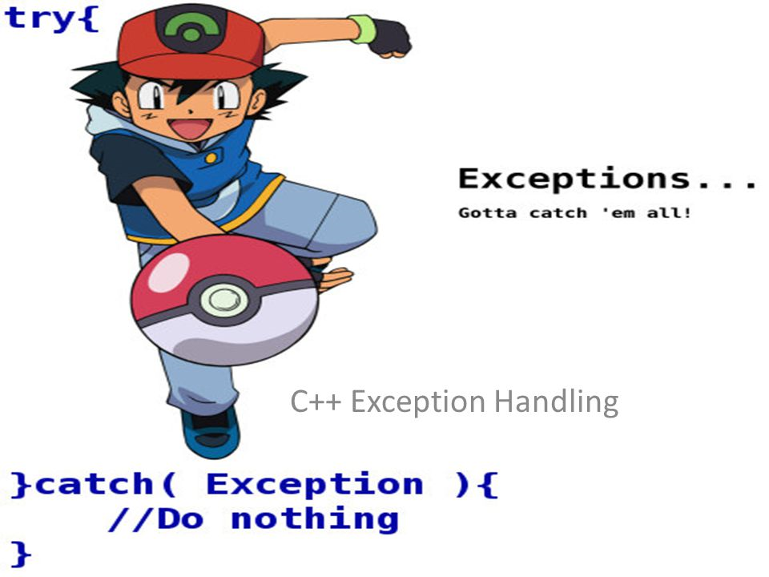
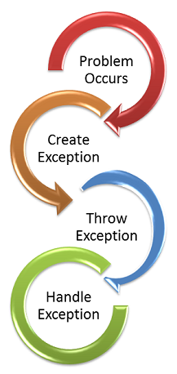
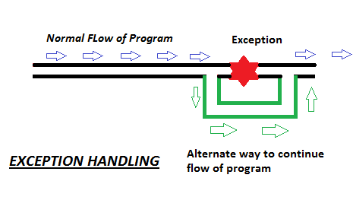
Exception Handling

Slide 2
Exception Handling
Exception
The abnormal condition that arises in a code sequence at runtime
Exception Handling
Exception Handling is a mechanism to handle runtime errors

Slide 3
Exception Handling
In java Exception is handled by five keywords
Try
Catch
Throw
Throws
Finally

Slide 4
Exception Handling
Syntax
Try
{
//block of code to monitor error
}
Catch(Exception type1_exception)
{
//exception handler for exception type 1
}
Catch(Exception type2_exception)
{
//exception handler for exception type 2
}
Finally
{
//block of code to be executed before try block end
}

Slide 5
Exception Handling
Using try and catch
The code to be monitored is placed try block
The code for handling exception is placed in catch block.
Using throw
Used to throw exception manually
Syntax
throw Throwable Instance;

Slide 6
Exception Handling
Using throws
Used to throw exception out of method
Syntax
Type method_name(parameter_list) throw exception_list
{
//body of method;
}
Finally
It contain block of code to be executed after try/catch block is completed.
It is executed if exception is thrown or not.

